Slide 1



Cryptography and Network Security
1. Overview
Lectured by
Nguyễn Đức Thái

Slide 2
Outline
Security concepts
X.800 security architecture
Security attacks, services, mechanisms
Models for network (access) security
Network security terminologies

Slide 3
Outline
Khái niệm bảo mật
Kiến trúc an ninh X.800
Các cuộc tấn công an ninh, dịch vụ, cơ chế
Mô hình cho (truy cập) an ninh mạng
Thuật ngữ an ninh mạng

Slide 4






Computer Security Objectives
Confidentiality
• Data confidentiality
Assures that private or confidential information is not made available or disclosed to unauthorized individuals
• Privacy
Assures that individuals control or influence what information related to them may be collected and stored and by whom and to whom that information may be disclosed
Integrity
• Data integrity
Assures that information and programs are changed only in a specified and authorized manner
• System integrity
Assures that a system performs its intended function in an unimpaired manner, free from deliberate or inadvertent unauthorized manipulation of the system
Availability
• Assures that systems work promptly and service is not denied to authorized users

Slide 5
Mục tiêu bảo mật máy tính
Confidentiality (Bảo mật)
• Bảo mật dữ liệu
Đảm bảo rằng thông tin cá nhân hoặc bí mật không được cung cấp hoặc tiết lộ cho các cá nhân trái phép
• Riêng tư
Đảm bảo rằng các cá nhân kiểm soát hoặc tác động những gì thông tin liên quan đến họ có thể được thu thập và lưu trữ và bởi ai và cho ai thông tin có thể được tiết lộ .
Integrity (Tính toàn vẹn).
• Toàn vẹn dữ liệu (Data integrity)
Đảm bảo thông tin và các chương trình được thay đổi chỉ trong một cách thức quy định và có thẩm quyền
• Hệ thống toàn vẹn (System integrity)
Đảm bảo rằng một hệ thống thực hiện chức năng dự định của nó một cách nguyên vẹn, miễn phí từ thao tác trái phép cố ý hoặc vô ý của hệ thống
Availability (sẵn sang).
• Đảm bảo rằng các hệ thống làm việc kịp thời, dịch vụ không bị từ chối cho người dùng hợp lệ.

Slide 6
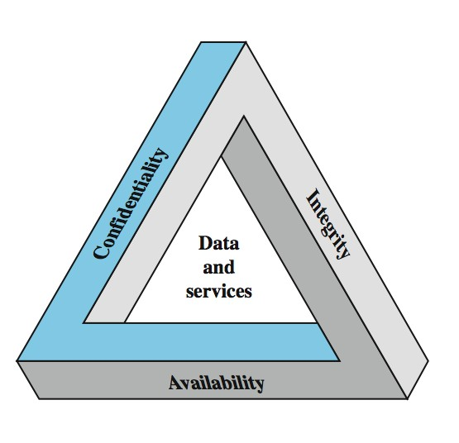
CIA Triad (CIA Tam Hoàng)
Các yêu cầu an Tam Hoàng

Slide 7


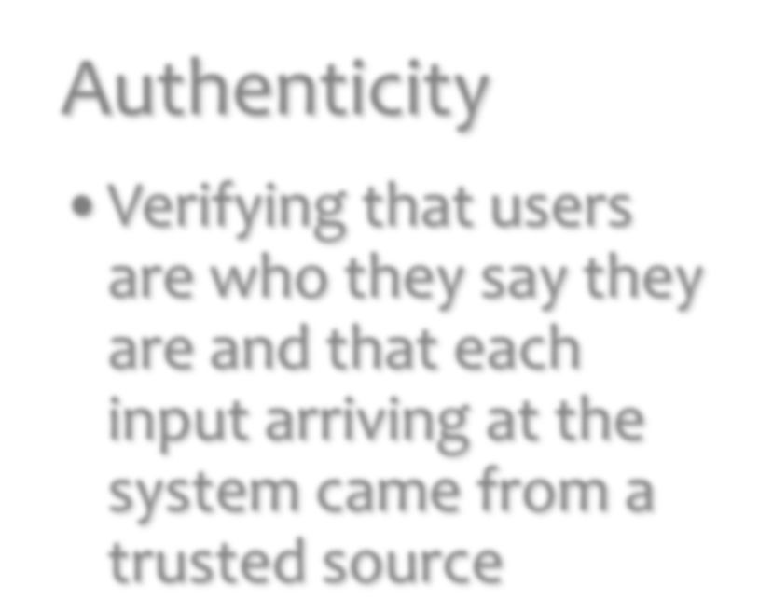
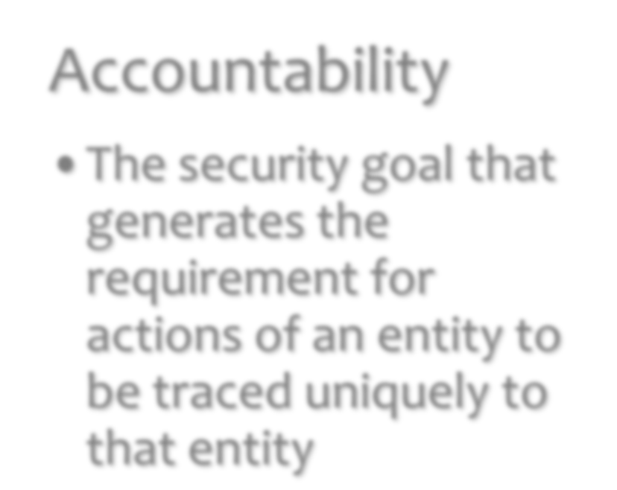












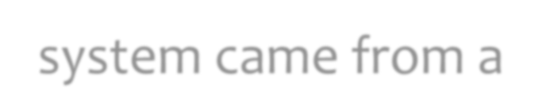



Possible Additional Concepts (Có thể xảy khái niệm bổ sung)
Authenticity
•Verifying that users are who they say they are and that each input arriving at the system came from a trusted source
Accountability
•The security goal that generates the requirement for actions of an entity to be traced uniquely to that entity

Slide 8
Có thể xảy khái niệm bổ sung
Tính xác thực
• Thẩm định rằng người sử dụng là những gì họ nói là và mỗi đầu vào đến tại hệ thống đến từ một nguồn đáng tin cậy
Trách nhiệm
• Các mục tiêu an ninh đó tạo ra những yêu cầu đối với các hành động của một tổ chức được truy tìm chất riêng thực thể đó

Slide 9

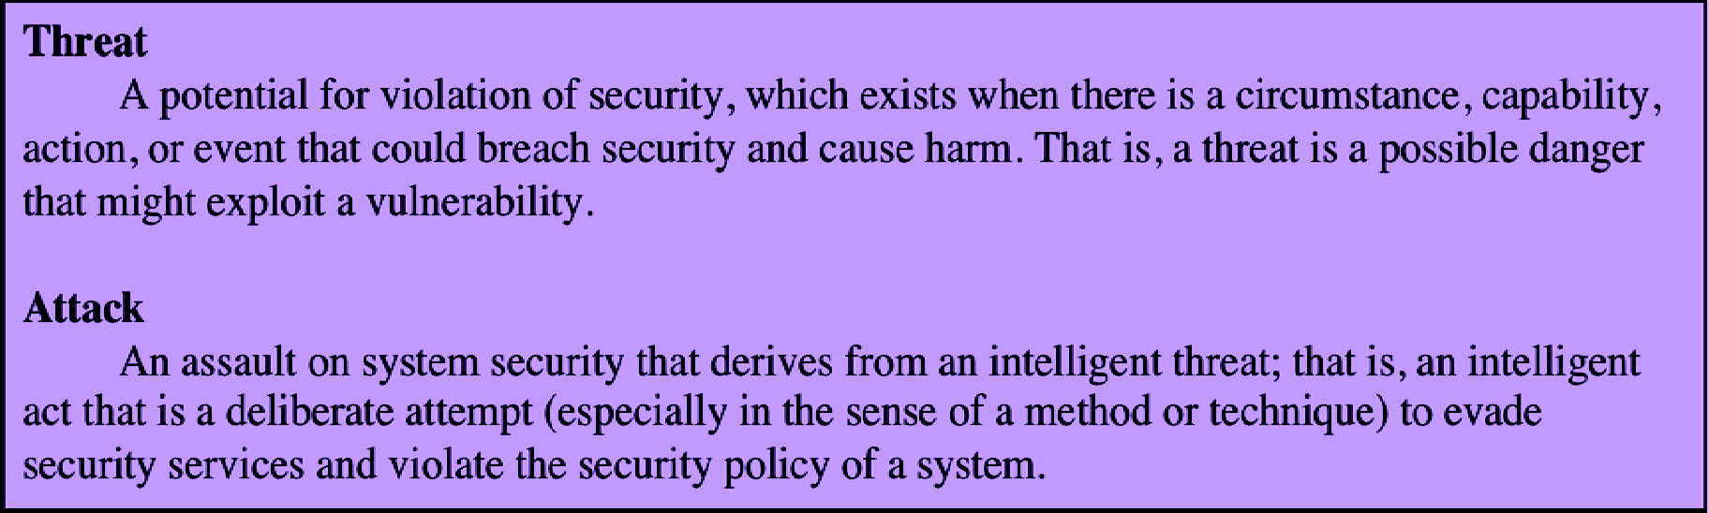
Terms (thuật ngữ)

Slide 10
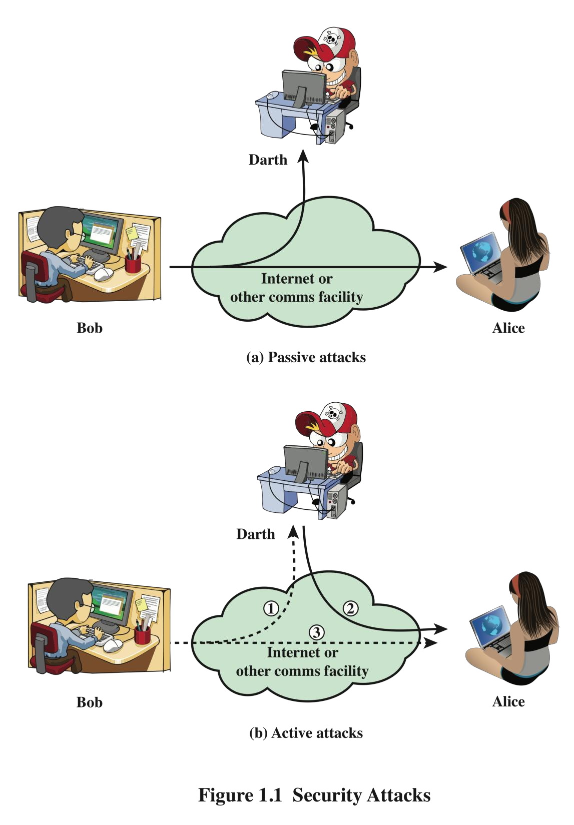
Security Attacks
A means of classifying security attacks, used both in X.800 and RFC 4949, is in terms of passive attacks and active attacks
A passive attack attempts to learn or make use of information from the system but does not affect system resources
An active attack attempts to alter system resources or affect their operation

Slide 11
Passive Attacks
Passive attacks are in the nature of eavesdropping on, or monitoring of, transmissions.
The goal of the opponent is to obtain information that is being transmitted.
Two types of passive attacks are
the release of message contents and
traffic analysis.

Slide 12










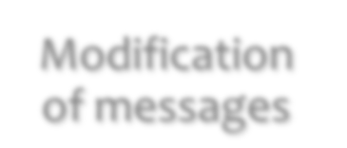





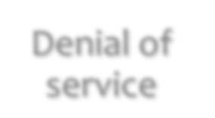


Active Attacks
Involve some modification of the data stream or the creation of a false stream
•Takes place when one entity pretends to be a different entity
•Usually includes one of the other
forms of active attack
Masquerade
Difficult to prevent because of the wide variety of potential physical, software, and network vulnerabilities
•Involves the passive capture of a data unit and its subsequent retransmission to produce an unauthorized effect
Replay
Goal is to detect attacks and to recover from any disruption or delays caused by them
•Some portion of a legitimate message is altered, or messages are delayed or reordered to produce an unauthorized effect
Modification of messages
Denial of service
•Prevents or inhibits the normal use or management of communications facilities

Slide 13
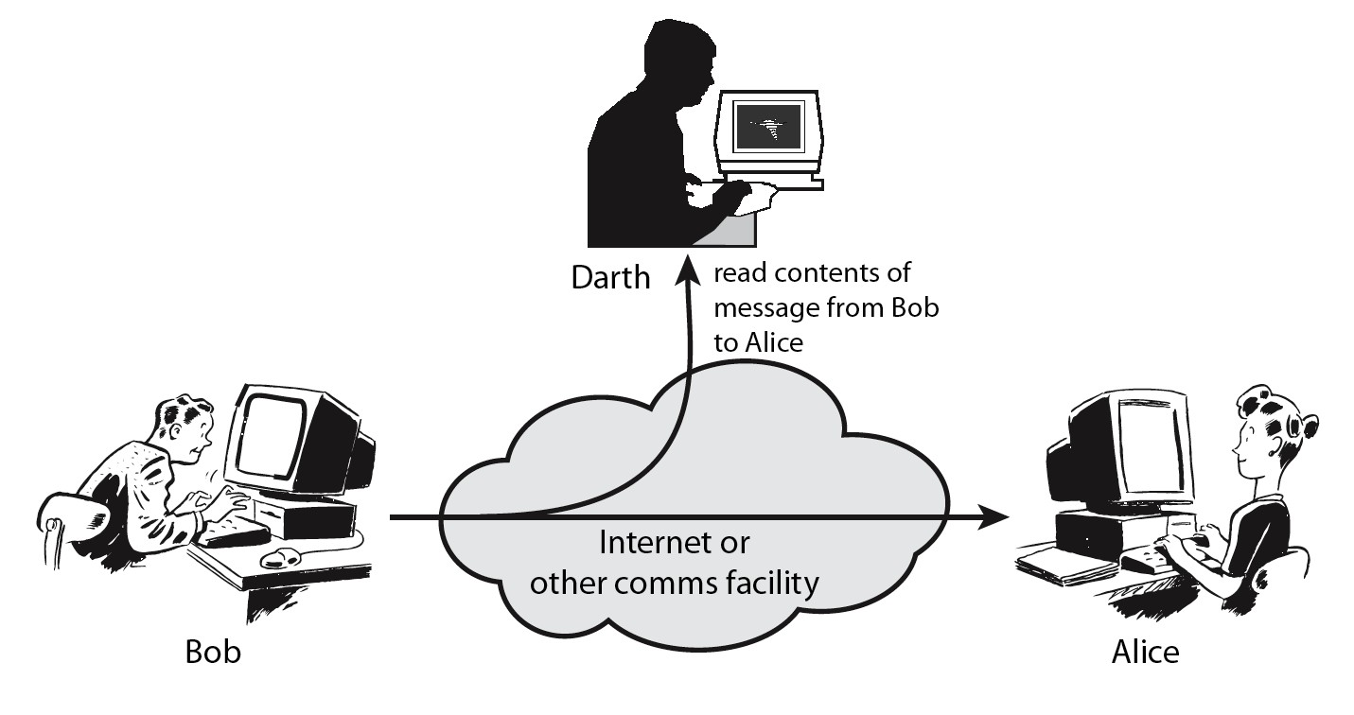
Passive Attacks - Interception
Release of message contents

Slide 14
Passive Attacks – Traffic Analysis
Observe traffic pattern
Traffic analysis

Slide 15
Handling Attacks
Passive attacks – focus on Prevention
Easy to stop
Hard to detect
Active attacks – focus on Detection and Recovery
Hard to stop
Easy to detect

Slide 16
Security Services (X.800)
Authentication - assurance that communicating entity is the one claimed
have both peer-entity & data origin authentication
Access Control - prevention of the unauthorized use of a resource
Data Confidentiality – protection of data from unauthorized disclosure
Data Integrity - assurance that data received is as sent by an authorized entity
Non-Repudiation - protection against denial by one of the parties in a communication
Availability – resource accessible/usable

Slide 17

Authentication
Concerned with assuring that a communication is authentic
In the case of a single message, assures the recipient that the message is from the source that it claims to be from
In the case of ongoing interaction, assures the two entities are authentic and that the connection is not interfered with in such a way that a third party can masquerade as one of the two legitimate parties
Two specific authentication services are defined in X.800:
Peer entity authentication
Data origin authentication

Slide 18
Access Control
The ability to limit and control the access to host
systems and applications via communications links
To achieve this, each entity trying to gain access must first be identified, or authenticated, so that access rights can be tailored to the individual

Slide 19
Data Confidentiality
The protection of transmitted data from passive attacks
Broadest service protects all user data transmitted between two users over a period of time
Narrower forms of service includes the protection of a
single message or even specific fields within a message
The protection of traffic flow from analysis
This requires that an attacker not be able to observe the source and destination, frequency, length, or other characteristics of the traffic on a communications facility

Slide 20




Data Integrity
Can apply to a stream of messages, a single message, or selected fields within a message
Connection-oriented integrity service, one that deals with a stream of messages, assures that messages are received as sent with no duplication, insertion, modification, reordering, or replays
A connectionless integrity service, one that deals with individual messages without regard to any larger context, generally provides protection against message modification only

Slide 21
Non-repudiation
Prevents either sender or receiver from denying a
transmitted message
When a message is sent, the receiver can prove
that the alleged sender in fact sent the message
When a message is received, the sender can prove that the alleged receiver in fact received the message

Slide 22
Security Mechanism
As known as control
Feature designed to detect, prevent, or recover from
a security attack
No single mechanism that will support all services required
However one particular element underlies many of
the security mechanisms in use:
cryptographic techniques

Slide 23


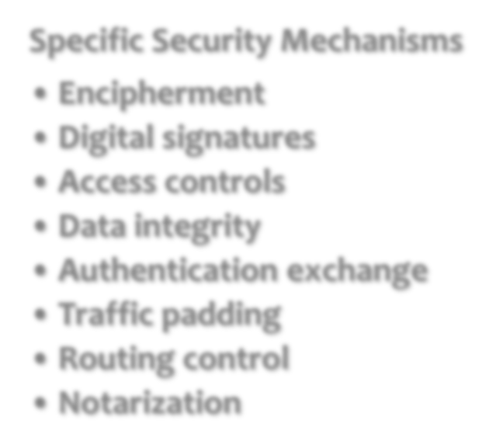







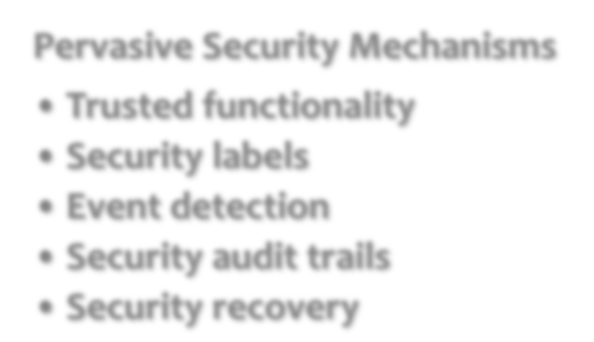















Security Mechanism (X.800)
Specific Security Mechanisms
Encipherment
Digital signatures
Access controls
Data integrity
Authentication exchange
Traffic padding
Routing control
Notarization
Pervasive Security Mechanisms
Trusted functionality
Security labels
Event detection
Security audit trails
Security recovery

Slide 24
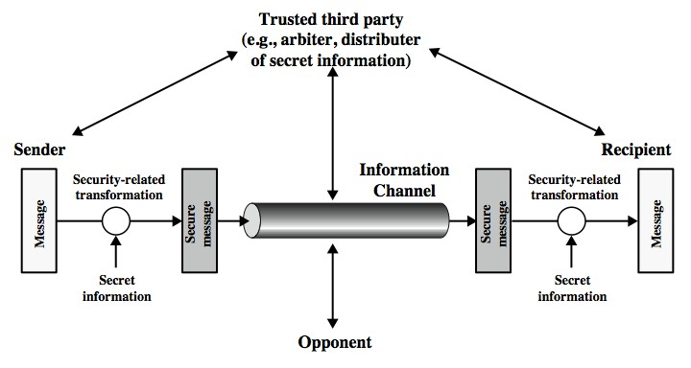
A Model for Network Security

Slide 25
A Model for Network Security
Using this model requires us to:
design a suitable algorithm for the security
transformation
generate the secret information (keys) used by the algorithm
develop methods to distribute and share the secret information
4. specify a protocol enabling the principals to use the transformation and secret information for a security service
22

Slide 26
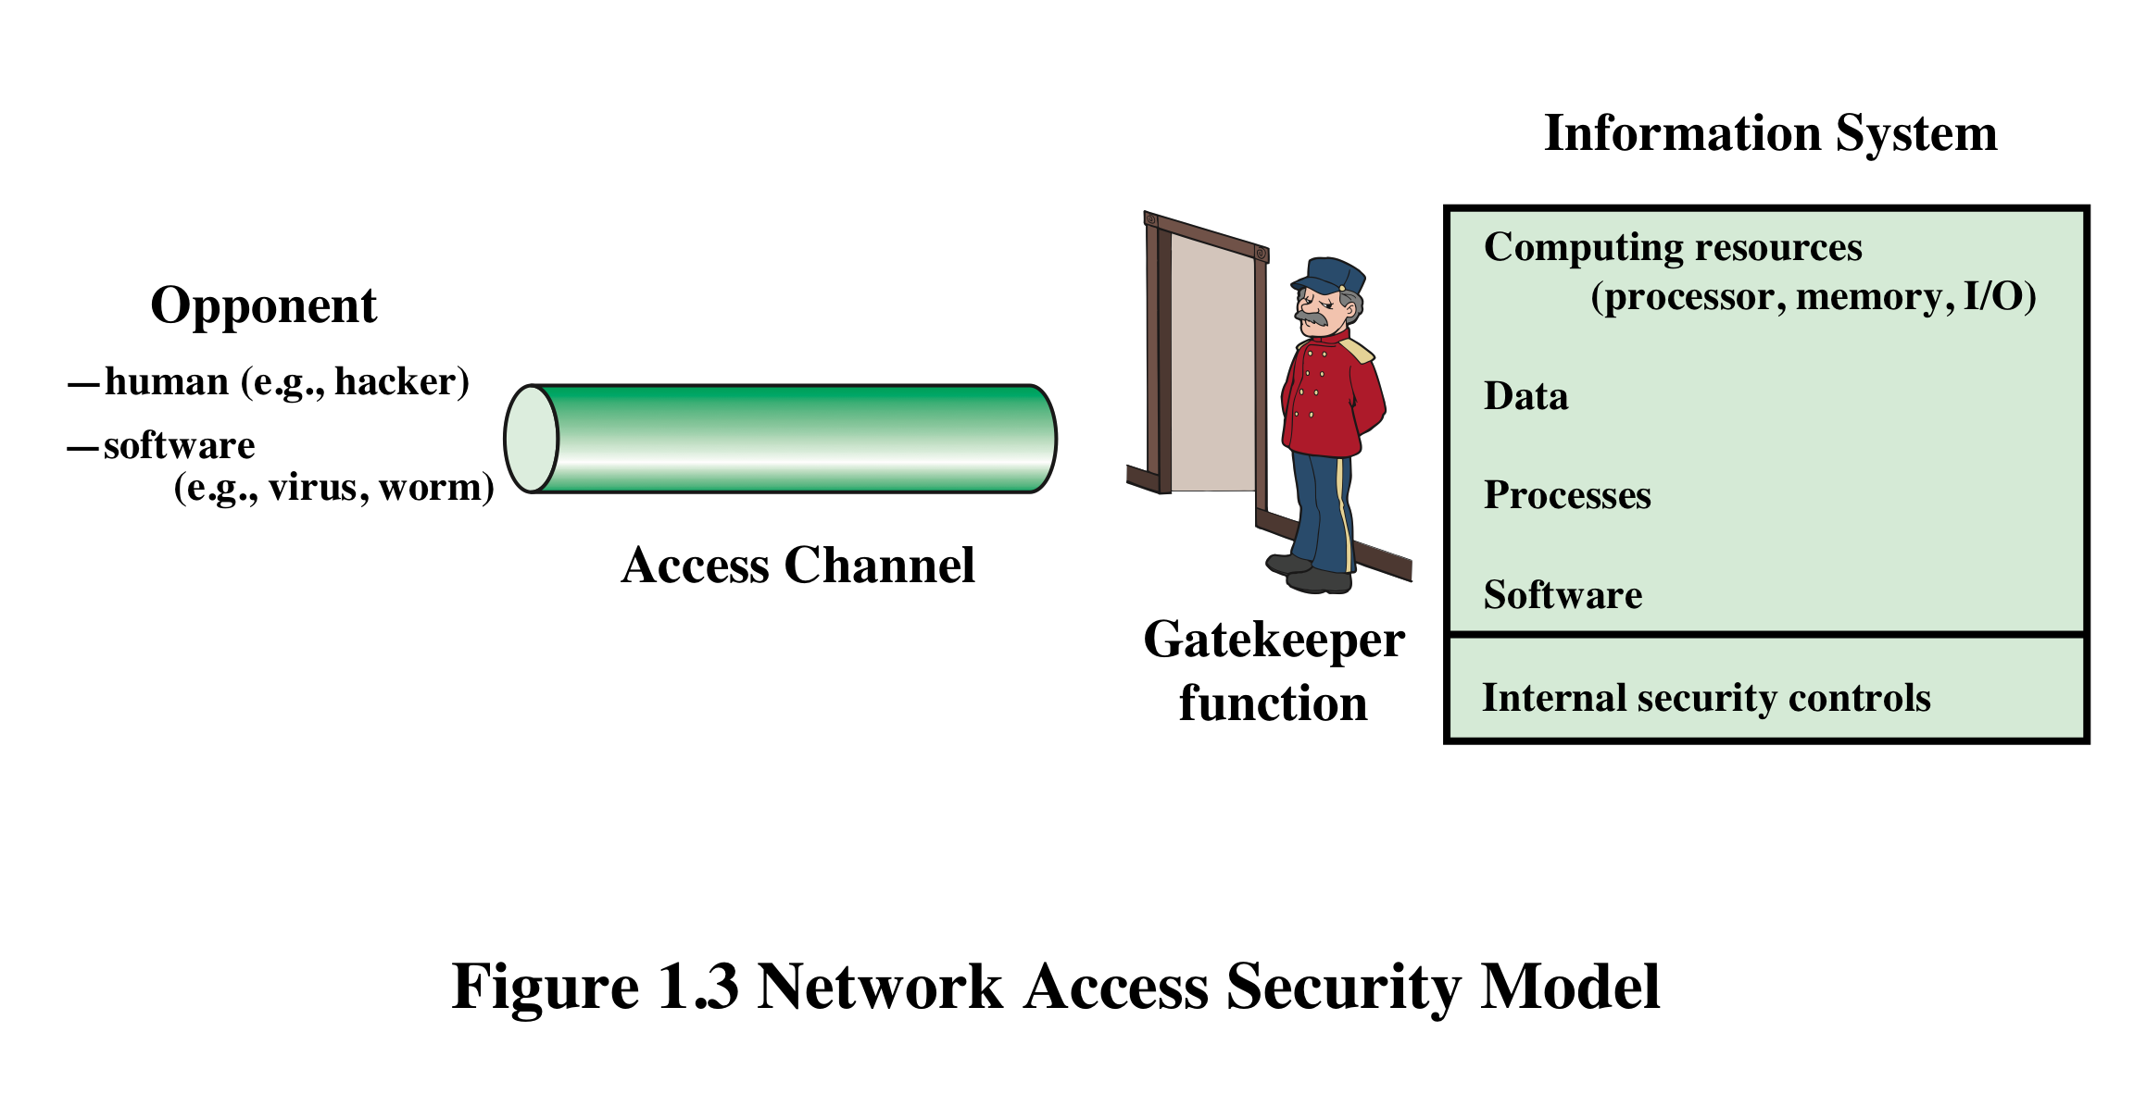
A Model for Network Access Security

Slide 27
A Model for Network Access Security
Using this model requires us to:
Select appropriate gatekeeper functions to identify
users
Implement security controls to ensure only authorised users access designated information or resources
Note that model does not include:
monitoring of system for successful penetration
monitoring of authorized users for misuse
audit logging for forensic uses, etc.

Slide 28
Unwanted Access
Placement in a computer system of logic that exploits vulnerabilities in the system and that can affect application programs as well as utility programs such as editors and compilers
Programs can present two kinds of threats:
Information access threats
Intercept or modify data on behalf of users who should not have access to that data
Service threats
Exploit service flaws in computers to inhibit use by legitimate users

Slide 29
Some Basic Terminologies
plaintext - original message
ciphertext - coded message
cipher - algorithm for transforming plaintext to ciphertext
key - info used in cipher known only to sender/receiver
encipher (encrypt) - converting plaintext to ciphertext
decipher (decrypt) - recovering plaintext from ciphertext
cryptography - study of encryption principles/methods
cryptanalysis (codebreaking) - study of principles/ methods of deciphering ciphertext without knowing key
cryptology - field of both cryptography and cryptanalysis

Slide 30
Summary
Security concepts
Confidentiality,
Integrity,
Availability
X.800 security architecture
Security attacks, services, mechanisms
Models for network (access) security

